Slide 1
DKPro – Darmstadt Knowledge Processing Software Repository
Elisabeth Wolf, Torsten Zesch, Iryna Gurevych
Ubiquitous Knowledge Processing (UKP) Lab
Prof. Dr. Iryna Gurevych
Fachbereich Informatik
Technische Universität Darmstadt
Notes:
|
| <number>

Slide 2

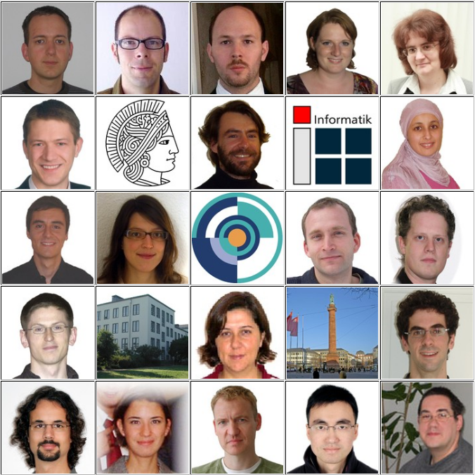

DKPro - Darmstadt Knowledge Processing Software Repository
2007: Projektstart
2008: 1. Release
  Ausgezeichnet mit einem IBM UIMA Innovation Award 2007 und zwei IBM Unstructured Information Analytics (UIA) Awards 2008
15.05.2009 | Computer Science Department | Ubiquitous Knowledge Processing Lab | © Prof. Dr. Iryna Gurevych
Notes:
12. Mai 2008
|
| <number>
12. Mai 2008
|
| <number>

Slide 3

Motivation
Forschung in der Computerlinguistik Experimente
…
Annotationen
Ergebnisse
15.05.2009 | Computer Science Department | Ubiquitous Knowledge Processing Lab | © Prof. Dr. Iryna Gurevych

Slide 4
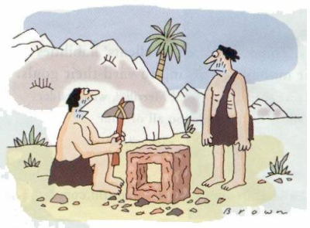
Motivation
Forschung in der Computerlinguistik Experimente
For her, technology is a comprehensive system that includes methods,procedures, and organization.
She distinguishes between holistic technologies used by craft workers or artisans and prescriptive ones.
Annotationen
Ergebnisse
Hi Micheal,
have u seen my posting,last week u said that u will look in to my problem this week.
15.05.2009 | Computer Science Department | Ubiquitous Knowledge Processing Lab | © Prof. Dr. Iryna Gurevych

Slide 5
UIMA - Unstructured Information Management Architecture
Framework zur Programmierung von NLP-Anwendungen
  entwickelt von IBM
  heute Open Source
  einheitliche Schnittstellen
  Wiederverwendbarkeit
Web
PDF
XML
Data import
Named Entity Recognition
Data export
15.05.2009 | Computer Science Department | Ubiquitous Knowledge Processing Lab | © Prof. Dr. Iryna Gurevych

Slide 6
UIMA - Unstructured Information Management Architecture
Framework zur Programmierung von NLP-Anwendungen
  entwickelt von IBM
  heute Open Source
  einheitliche Schnittstellen
  Wiederverwendbarkeit
Web
PDF
XML
Data import
Sentence splitter
Tokenizer
Stopword tagger
PoS tagger
Named Entity Recognition
Named entity tagger
Data export
15.05.2009 | Computer Science Department | Ubiquitous Knowledge Processing Lab | © Prof. Dr. Iryna Gurevych

Slide 7
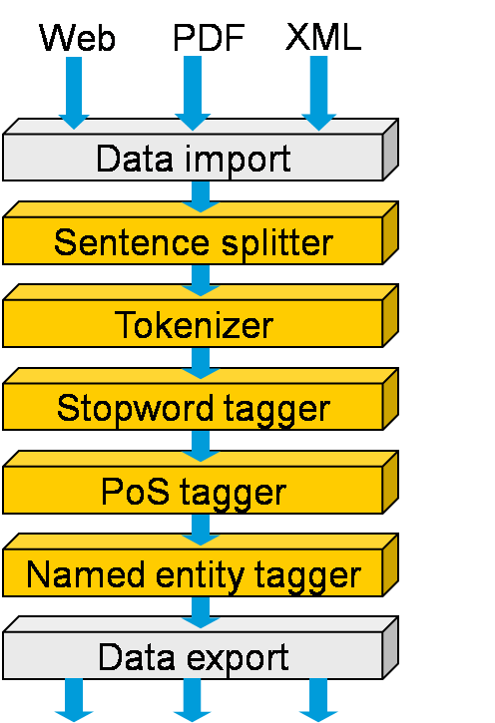
DKPro - Darmstadt Knowledge Processing Software Repository
  Software Repository
    “Plug and Play” Komponenten
    aufeinander abgestimmt
    komplexe Anwendungen leicht zu realisieren
15.05.2009 | Computer Science Department | Ubiquitous Knowledge Processing Lab | © Prof. Dr. Iryna Gurevych

Slide 8
DKPro - Releases
DKPro UGD
geplant: 2009
User Generated Discourse
DKPro Core
Released 2008
NLP - Basiskomponenten
Information Retrieval
Keyphrase Extraction
„Philosophie“
Integriere bestehende
+
entwickle neue
Komponenten
Semantic Resources
…
15.05.2009 | Computer Science Department | Ubiquitous Knowledge Processing Lab | © Prof. Dr. Iryna Gurevych

Slide 9
DKPro – Core
Web
PDF
XML
Tokenizer
Stemmer
Sentence splitter
Data import
Lemmatizer
Stopword tagger
Linguistic preprocessing
Compound splitter
Morphological analysis
PoS tagger
Named entity tagger
Syntactic analysis
Parser
Sentiment detector
Semantic analysis
Project specific analysis
Named entity disambiguation
Word sense disambiguation
Data export
Email analysis
15.05.2009 | Computer Science Department | Ubiquitous Knowledge Processing Lab | © Prof. Dr. Iryna Gurevych

Slide 10
DKPro – User Generated Discourse
Inhalte aus E-Mails, Foren, Chats, Mailinglisten, Blogs, Wikis
enthalten Schreibfehler, Abkürzungen, ☺, …
Satzgrenzen erkennen
Hi
Micheal,
have u seen my posting,last week u said that u will look in to my problem thsi week.can i ask u now ☺ ?
Kürzel
auflösen
Tokenisierung
Sprachen-
erkennung
Rechtschreib-
prüfung
14.05.2009 | Computer Science Department | Ubiquitous Knowledge Processing Lab | © Prof. Dr. Iryna Gurevych

Slide 11
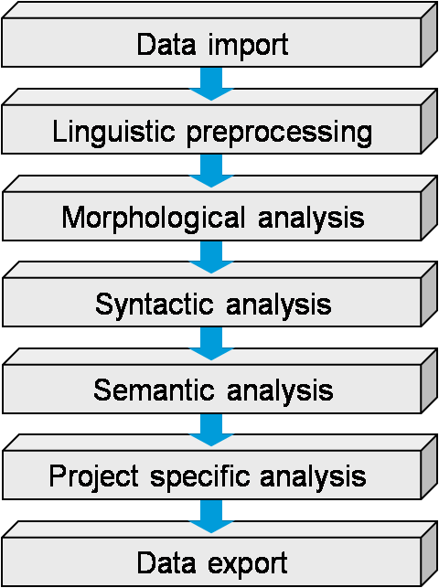
DKPro – Information Retrieval
1. Indexing
2. Retrieval
Documents
Topics
Lucene Index Writer
Evaluation
Index
Terrier
Document
Index
Topic
Index
Rankings
15.05.2009 | Computer Science Department | Ubiquitous Knowledge Processing Lab | © Prof. Dr. Iryna Gurevych

Slide 12
DKPro – Keyphrase Extraction
CHICAGO, Oct 29 - Kraft Foods Inc and Kellogg Co posted better-than-expected third-quarter profits on Wednesday as price increases and new products helped lift sales in a weak economy. Kraft also stood by its forecasts for 2008 earnings before one-time items as well as for 2009 net income, while Kellogg said its profit this year should hit the high end of its previous targeted range. Both Kraft, the largest North American food maker, and Kellogg, the world's largest cereal company, have taken steps to cut costs and put more money into advertising. Both have also bolstered new product development to attract consumers even as rising commodity costs pushed them to raise prices. Commodities like wheat and energy have become less expensive in recent months, but food companies may not see a big benefit until next year, in part because they lock in their costs months ahead. Kraft, which makes Oreo cookies, Tang breakfast drink and Oscar Mayer hot dogs, reported a profit of 45 cents a share before one-time items, a penny above what analysts polled by Reuters Estimates had expected. The company hiked prices on products, leading to a 0.9 percent drop in volume. However, that key result was still better than the company had expected. Analysts are watching to see how much consumers cut back on buying branded products in the face of rising food prices and a slumping economy. Kraft sales rose 19.4 percent to $10.46 billion. Organic sales, which exclude the impact of currency, acquisitions and divestitures, rose 7.1 percent due to higher pricing. Over the past several years, Kraft has closed factories, cut jobs and divested brands to focus on areas like cookies and crackers, pizza and healthier foods. Shares of Kraft rose 1.8 percent to $29.39 in premarket trading from Tuesday's closing price of $28.88 on the New York Stock Exchange, while Kellogg stock was not active. Kellogg, the maker of Rice Krispies and Eggo waffles, said net income rose to 89 cents a share from 76 cents a year earlier. The results were far better than the 80 cents analysts had forecast.
15.05.2009 | Computer Science Department | Ubiquitous Knowledge Processing Lab | © Prof. Dr. Iryna Gurevych
Notes:
12. Mai 2008
|
| <number>

Slide 13
DKPro – Keyphrase Extraction
CHICAGO, Oct 29 - Kraft Foods Inc and Kellogg Co posted better-than-expected third-quarter profits on Wednesday as price increases and new products helped lift sales in a weak economy. Kraft also stood by its forecasts for 2008 earnings before one-time items as well as for 2009 net income, while Kellogg said its profit this year should hit the high end of its previous targeted range. Both Kraft, the largest North American food maker, and Kellogg, the world's largest cereal company, have taken steps to cut costs and put more money into advertising. Both have also bolstered new product development to attract consumers even as rising commodity costs pushed them to raise prices. Commodities like wheat and energy have become less expensive in recent months, but food companies may not see a big benefit until next year, in part because they lock in their costs months ahead. Kraft, which makes Oreo cookies, Tang breakfast drink and Oscar Mayer hot dogs, reported a profit of 45 cents a share before one-time items, a penny above what analysts polled by Reuters Estimates had expected. The company hiked prices on products, leading to a 0.9 percent drop in volume. However, that key result was still better than the company had expected. Analysts are watching to see how much consumers cut back on buying branded products in the face of rising food prices and a slumping economy. Kraft sales rose 19.4 percent to $10.46 billion. Organic sales, which exclude the impact of currency, acquisitions and divestitures, rose 7.1 percent due to higher pricing. Over the past several years, Kraft has closed factories, cut jobs and divested brands to focus on areas like cookies and crackers, pizza and healthier foods. Shares of Kraft rose 1.8 percent to $29.39 in premarket trading from Tuesday's closing price of $28.88 on the New York Stock Exchange, while Kellogg stock was not active. Kellogg, the maker of Rice Krispies and Eggo waffles, said net income rose to 89 cents a share from 76 cents a year earlier. The results were far better than the 80 cents analysts had forecast.
15.05.2009 | Computer Science Department | Ubiquitous Knowledge Processing Lab | © Prof. Dr. Iryna Gurevych
Notes:
12. Mai 2008
|
| <number>

Slide 14
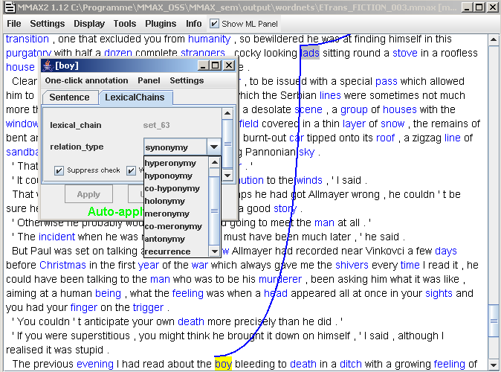
DKPro – Semantic Resources
z.B.
Lexical chain
annotator
JWNL
WordNet
GN API
GermaNet
?
Wikipedia
?
Wiktionary
15.05.2009 | Computer Science Department | Ubiquitous Knowledge Processing Lab | © Prof. Dr. Iryna Gurevych
Notes:
|
| <number>

Slide 15

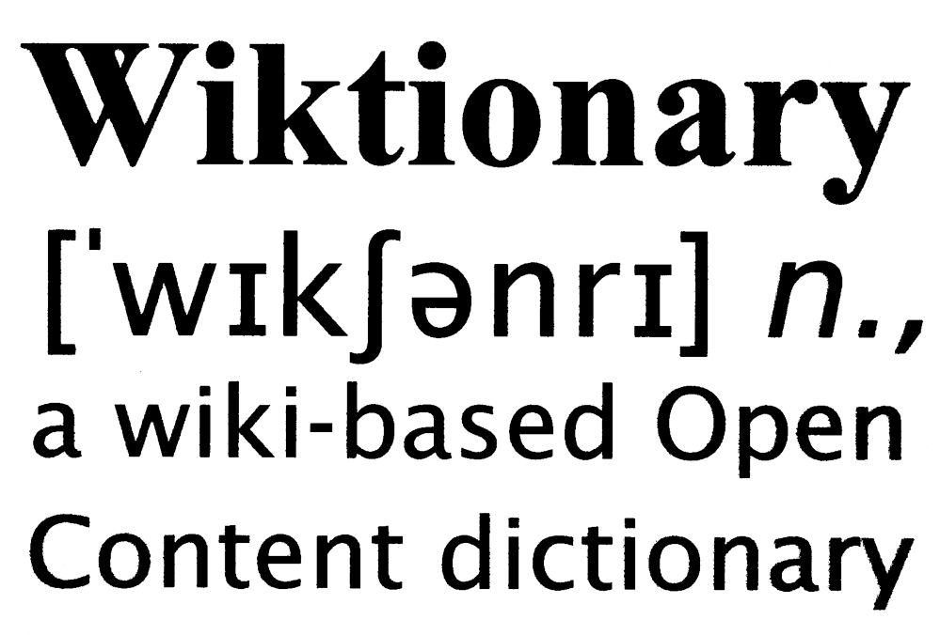
Poster Session
Programmierschnittstelle für
über 800 Downloads
seit Juni 2007
über 100 Downloads
seit Dezember 2008
Artikel, Links, Redirects,
Paragraphen, Kategorien,
Tabellen, …
Definitionen, Beispiele,
Synonyme, Hyperonyme,
Hyponyme, Wortart, …
JWPL
JWKTL
15.05.2009 | Computer Science Department | Ubiquitous Knowledge Processing Lab | © Prof. Dr. Iryna Gurevych
Notes:
u.a. führende Forschunsgruppen … Stanford University, Johns Hopkins University, Carnegie Mellon University, Berkeley
|
| <number>

Slide 16






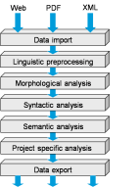

Vielen Dank !
Ubiquitous Knowledge Processing Lab
http://www.ukp.tu-darmstadt.de
DKPro, Wikipedia und Wiktionary API
http://www.ukp.tu-darmstadt.de/software
15.05.2009 | Computer Science Department | Ubiquitous Knowledge Processing Lab | © Prof. Dr. Iryna Gurevych
Notes:
12. Mai 2008
|
| <number>

